Slide 1
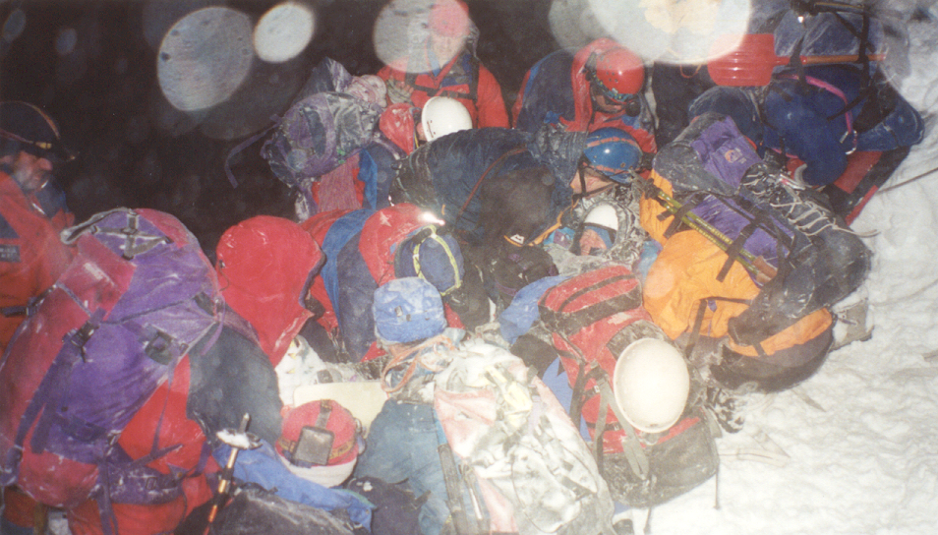
Aberdeen Mountain Rescue Team
Friends in High Places
With our sincere thanks to
Mario Di Maio
Aberdeen Mountain Rescue Team

Slide 2
How to get help
Dial 999
Ask for Police
When connected to the Police ask for Mountain Rescue.
Make sure you tell the operator that you require the Police – Not an Ambulance!
Do Not change your location until contacted by the Police and the Rescue Team.

Slide 3
Important Information that the Police and Rescue Team will need.
Your location (grid reference or what3words)
Your name
The name, gender and age of the casualty
Nature of the injuries or the emergency
Number of people in the party
Your mobile phone number
Keep a notebook in your rucksack and write these details before making the call

Slide 4
In the meantime: caring for the Casualty
Suppose that you are with a group on Ben Macdui when a member of your party stumbles and falls on the boulder field near the summit Cairn. Unable to stand or walk and complaining of severe pain in right upper leg and lower back.
Casualty evacuated by stretcher
to road head and transferred to Ambulance for journey to hospital
Incident
Rescue Team arrives on site
3 hours
Down to you!
1
2
3
4
5
6
7
8
Helicopter arrives at Hospital
20 minutes after picking up casualty
Casualty arrives at Hospital 8 hours + after the initial call
Helicopter on site with Paramedic in
45 minutes from the time of the initial call to the Police
You might have to stabilize and care for the casualty for some considerable time before help arrives!
Note: Helicopters are only rarely available

Slide 5
Think About
General Skills
Planning
Know your party
Know your capabilities
Know your limits
Plan for the worst!
Planning
Navigation in difficult conditions
Safe and confident movement on challenging terrain
Self Awareness
Self Reliance
Knowledge of “patch”
Basic First Aid

Slide 6
What are you carrying?
Good quality Waterproofs – Jacket and trousers
Additional insulating layers plus hat and gloves.
Food – more than you would intend or expect to be eating in the course of the day. Good idea to have some energy bars always in your rucsack.
Water, Hot Drink.
Shelter – Group Shelter, individual Bivi Bag.
Map & Compass, Whistle.
First Aid kit.
Torch and spare batteries
Mobile phone & battery booster.

Slide 7
Before you set out
Charge your phone. Many incident occur towards the end of the day when you and your phone might be low on energy!
Plan your route carefully. Consider the time of year, terrain and the nature of the trip, the skills and capabilities of yourself and the members of your party - and chose your route accordingly. Remember in winter it gets dark early.
Check the weather forecast and general hill conditions.
Leave details of your planned route. Include start and finish points and an estimated time of return. Ideally this information should be left with someone reliable who can raise the alarm if needed.
Eat well before you start out and remember to eat and hydrate during the trip.

Slide 8
Mountain Awareness
Weather
Daylight
Objective hazards and possible dangers
Subjective elements

Slide 9
Sources of Information

Slide 10
In the Mountains
Keep an eye on the weather – Accurate forecasts for mountain areas are more difficult to predict. Wind, rain and cloud cover and also cloud height may be more extreme than forecast indicated.
Keep the party together and be ready to reassess your route and objective should conditions on the hill or that of members of the party cause concern.
Watch for signs of fatigue, hypothermia or general unwellness within the party.
Keep a close eye on children or inexperienced members of the party.
Beware the passage of time and again reassess your objective if you think that continuing with you original plan is likely to have you going significantly beyond your planned schedule.

Slide 11
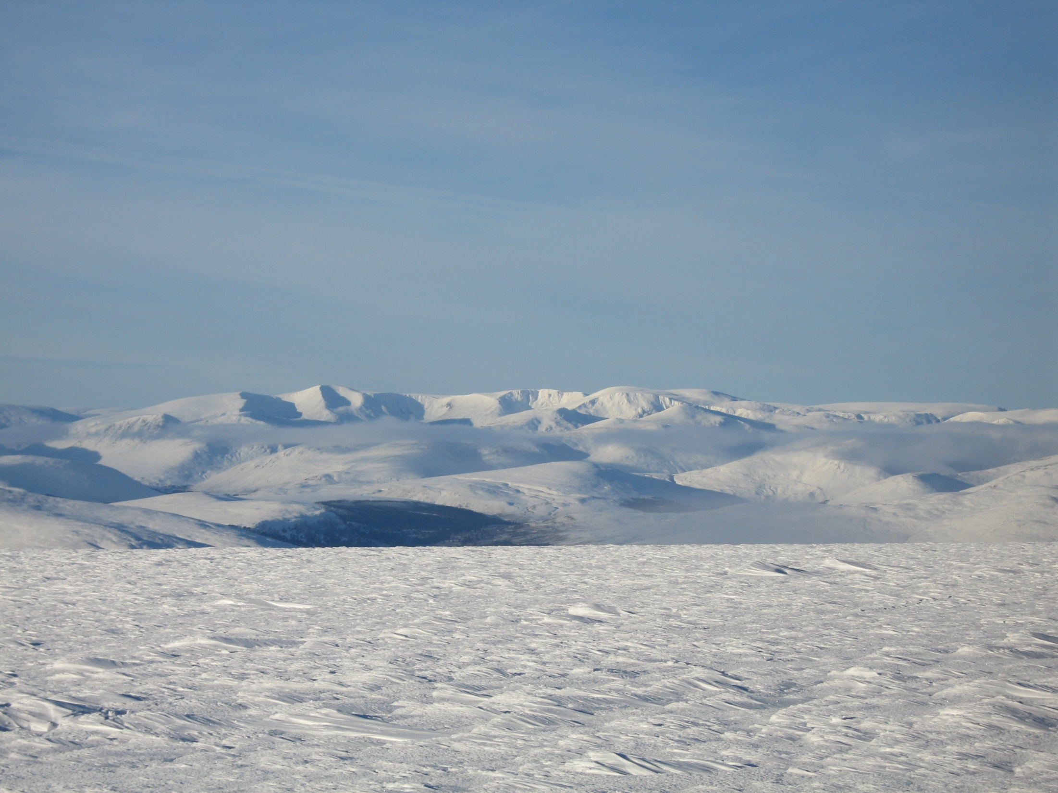
I say, climb if you will, but remember that courage and strength are naught without prudence, and that a momentary negligence may destroy the happiness of a lifetime. Do nothing in haste look well to each step and from the beginning think what may be the end.
Edward Whymper
Scrambles amongst the Alps 1871

Slide 12
SCOTTISH MOUNTAIN RESCUE 2022
27 Civilian Mountain Rescue Teams
Over 1000 Volunteers
3 Police Scotland Teams (Grampian/Strathclyde/Tayside)
1 Royal Airforce Team
Search & Rescue Dogs
Coast Guard Helicopters
Scottish Air Ambulance Helicopters

Slide 13
Scottish Mountain Rescue - 2022
636 Individual incidents
951 Callouts – an average of two every day
31,799 Volunteer hours
740 People assisted - plus 6 Dogs and several Sheep
255 People injured
21 Fatalities

Slide 14
Wind Chill

Slide 15
Future Challenges
Increase in callouts and additional tasking requests for MR Teams
Getting Volunteers
Technology
Public Expectations
Litigation
Funding. Please support our work either directly to Mountain Rescue or to our main funders: St John, Scotland

Slide 16
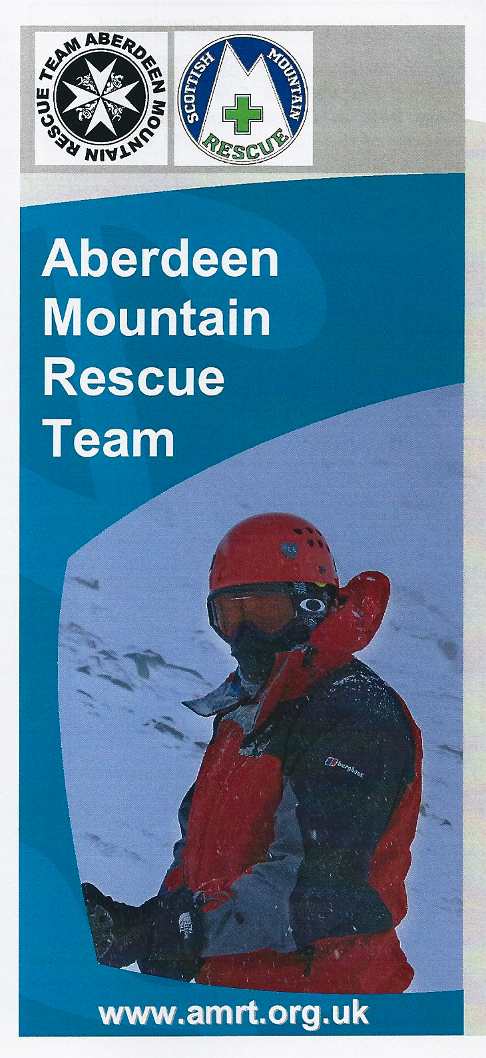
We are always looking for recruits!
Follow the Team on Facebook
and on our Website
amrt.org.uk

